Slide 1
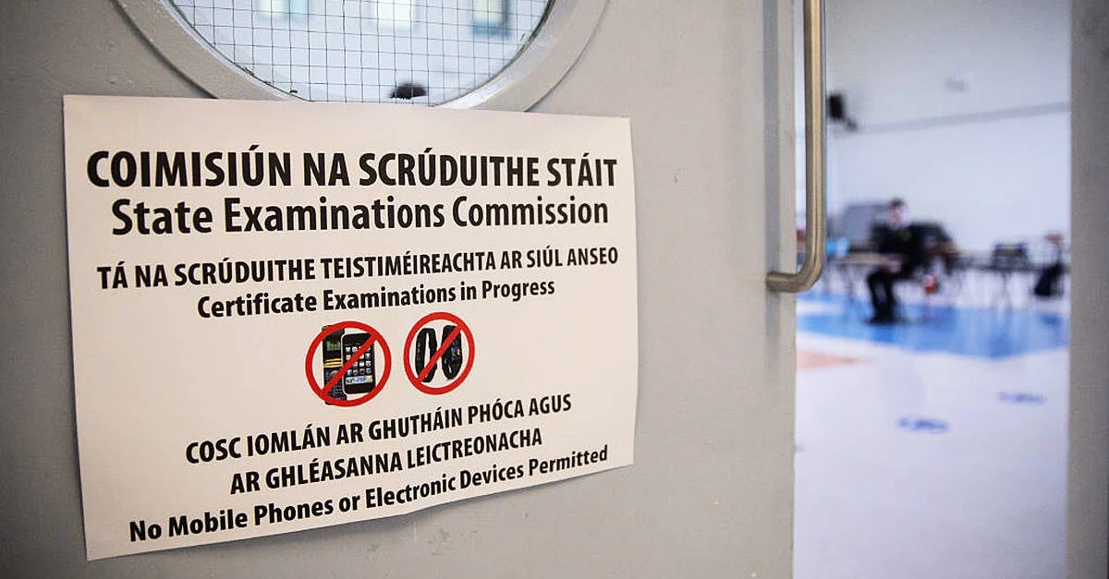





1914-1918
Chapter 39
EXAM PREPARATION
exam preparation
Junior Cycle History
@MsDoorley

Slide 2
Important Note 2024-2025
The sample paper produced by the State Examinations Commission in November 2020 contained ten questions.
The Junior Cycle History Final Examinations that students sat in June 2022, June 2023 and June 2024 contained only eight questions.
The 2025 exam will account for 100% of students’ final grade for Junior Cycle History as the 2025 cohort, as like the previous three cohorts, will not be completing the Assessment Task. These three cohorts have also only been required to complete one CBA as a result of the Covid provisions brought in by the Department of Education and Skills.
Junior Cycle History
Chapter Thirty-Nine: Exam Preparation
@MsDoorley

Slide 3
Structure, Timing and Marks
  Your Junior Cycle Final Examination for History will last 2 hours and is worth 360 marks – 90% of the total marks available for your Junior Cycle History grade.
  The other 10% (40 marks) is for your Assessment Task. (if you have been exempted from this by the Department of Education, your Final Exam accounts for 100% of your grade)
  Timing breakdown:
    If there are eight questions on the paper, you have 15 mins per question. (8 Qs = 15 mins)
    If there are ten questions on the paper, you have 12 mins per question. (10 Qs = 12 mins)
Junior Cycle History
Chapter Thirty-Nine: Exam Preparation
@MsDoorley

Slide 4
How to Complete Your Paper
  You must answer all questions on your paper.
  Answers must be entered into the answer spaces provided. If they are not – for example, if you write outside the lines – your work may not been seen by the examiner.
  Blue or black pen should be used. Do not use a pencil in your History exam.
  If you need space to plan an answer or do rough work, optional planning/rough work space is provided at the beginning of the exam paper.
Junior Cycle History
Chapter Thirty-Nine: Exam Preparation
@MsDoorley

Slide 5
How to Complete Your Paper
  If you make a mistake, you may cross it out or use correction tape (rather than fluid) and add the correction information.
  You will notice that many source documents appear on the History examination paper. Each question has a number of parts, some of which are based on the source, and others on your course knowledge. It is a good idea to read the question carefully and be sure you know whether you should answer based on the source or on your studied course material.
Junior Cycle History
Chapter Thirty-Nine: Exam Preparation
@MsDoorley

Slide 6
On the day of your Exam
  Bring your blue or black pens with you.
  Ensure your answers are the appropriate length. For example, a question with a small answer space might only require a sentence or two, but a question with a larger answer space may require a much longer response.
  Do not spend too much time on any one question – manage your time so that you can give equal effort to all parts of your examinations paper.
  Do not panic if something unfamiliar is asked in a question. Attempt it as best you can.
  Work neatly so that the examiner can easily understand your answers (write in print if needed).
  Write your answers in the spaces provided in the exam paper.
  If possible, allow time at the end to look over your work. Check that you have not skipped any parts of a question and/or add any relevant points or details that didn’t come to mind earlier to an answer.
Junior Cycle History
Chapter Thirty-Nine: Exam Preparation
@MsDoorley

Slide 7
1914-1918
Chapter 39
STUDY TIPS AND EXAM PREPARATION
study tips and exam preparation
Your written paper can include questions from any part of your course, so make sure to revise material from each of your three years of studying History.
As you revise in the days and weeks before your exam, keep the following advice in mind.
Junior Cycle History
@MsDoorley

Slide 8
Plan
  To begin your History revision, it is recommended that you make a list of the topics you need to revise.
  You have each been given a Revision Timetable (also available on Class Notebook and Teams) which contains a chapter by chapter list of your topics.
  The layout of this Revision Timetable is to divide two topics over the space of two weeks so you can set aside adequate time to revise each topic, up until the Easter Break.
Junior Cycle History
Chapter Thirty-Nine: Exam Preparation
@MsDoorley

Slide 9





Gold Stars denote topics which are choice to study.
34 TOPICS COVERED IN CLASS: YOU STUDY 30
The Historian | The Archaeologist | Ancient Ireland | Ancient Rome | Early Christian Ireland | The Middle Ages in England and Ireland | The Renassaince | The Age of Exploration and Conquest | The Reformation | The Irish Plantations | The American or French Revolution
The 1798 Irish Rebellion | Catholic Emancipation | The Industrial Revolution | The Great Irish Famine | Social, Cultural and Social Movements in 19th/20th Century Ireland | The Rise of Nationalism and Unionism in Ireland | The Struggle for Irish Independence | World War I | Life in Communist Russia | Life in Fascist Italy or Nazi Germany | World War II
Ireland During World War II | The Holocaust | The Cold War | The 1960s in Ireland | The 1960s in the USA | Women in 20th Century Ireland | The Troubles in Northern Ireland | European Integration/ The United Nations | Patterns of Change in Medicine | Patterns of Change in Technology | Patterns of Change in Crime and Punishment
Junior Cycle History
Chapter Thirty-Nine: Exam Preparation
Source Comprehension & Analysis
Writing Historically
Evidence | Reliability | Historically Useful | Objective/ Biased | Primary/ Secondary | Source Type
Write an account | Give an outline of/ Describe | What was the role of... | What were the causes of... | Explain the importance (significance) of | What was the outcome/ impact of | Explain changes/differences
360 Marks
Exam: 8 or 10 questions on the above topics
Common Level
2 Hours
All questions answered on the paper
Diagram adapted from @TheEnglishTeacher on Twitter
@MsDoorley

Slide 10
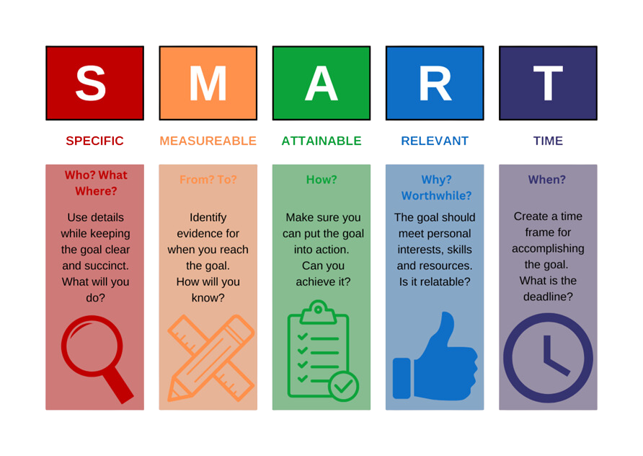
Write SMART goals
When planning how much you need to revise, it is a good ideas to use the method of SMART goal planning. This method can help you achieve more and be more realistic with your revision.
Junior Cycle History
Chapter Thirty-Nine: Exam Preparation
@MsDoorley

Slide 11
Revise
  You should reread any notes you have already on the topic and test yourself to see what you can recall.
  Say the information aloud, highlighting important points, and work through each section until you are confident you can remember it well.
  Flashcards can be of great help to break down topics into summary points.
    For many topics, you can take 5 causes, 5 courses (events), 5 consequences (results) and 5 effects on the people.
    Make use of your keyword sheets whenever you are stuck on some of the harder words you may come across.
Junior Cycle History
Chapter Thirty-Nine: Exam Preparation
@MsDoorley

Slide 12
Practise
  After you have refreshed your memory on a topic, it is best practice to then use your exam papers and the related questions to that topic.
  Try to complete the exam questions without your notes first. Keep an eye on timing; it is very important to work quickly and carefully in an exam setting.
  The more you practise, the more comfortable you will be by the time you sit your exam in June.
Junior Cycle History
Chapter Thirty-Nine: Exam Preparation
@MsDoorley

Slide 13
Review and Record
  Look over the questions you have just completed and check it against the information in your notes or the marking scheme provided by your teacher.
    Was your answer correct?
    Did you include examples if needed?
    Did you use the source to answer your question, when asked to?
    Did you leave anything out?
  This is your chance to go over any information you are not yet clear on once more.
  Keep note of which topics and questions you have covered, in line with your Revision Timetable.
Junior Cycle History
Chapter Thirty-Nine: Exam Preparation
@MsDoorley

Slide 14
1914-1918
Chapter 39
STUDY AND WELLBEING
study and wellbeing
Junior Cycle History
@MsDoorley

Slide 15
Taking Care of Yourself…
  The weeks or months coming up to an exam can be very busy and it is normal to feel schoolwork-related or exam-related anxieties and stresses.
  Your wellbeing is very important; you should make time to look after your mind and body, especially when you are busy with study or exams.
  Having lots to do in work and daily life is a big feature of adulthood too, so learning to balance things is a skill that will serve you well in the future.
Junior Cycle History
Chapter Thirty-Nine: Exam Preparation
@MsDoorley

Slide 16
Sleep
  Always aim to get a good night’s sleep. This is not as simple as planning to go to bed early or deciding to sleep in. Routine (going to bed and getting up at similar times each day) and the quality of your sleep are more important than the amount of time you spend lying in bed.
  Comfort – are your pillows supportive? Have you got bedcovers? If your bed tidy and inviting or is it littered with clothing and other things?
  Light – turn off overheard lights and use a bedside lap. Make sure curtains or blinds are fully closed.
  Temperature – aim not to be too warm or too cold. Use lighter covers, open or close windows, or wear lighter or warmer pyjamas depending on the season.
  Noise – some people need silence for sleep.
Junior Cycle History
Chapter Thirty-Nine: Exam Preparation
@MsDoorley

Slide 17
1914-1918
Chapter 39
GLOSSARY OF TERMS/ACTION VERBS
glossary of terms/action verbs
Junior Cycle History
@MsDoorley

Slide 18
Terms | Defintion
Based on your study/From your knowledge | The answer for this must be from your own knowledge and not from the sources in the exam paper.
Chronological Order | In the order in which they happened in time.
Compare | Identify the similarities and differences between two things.
Contribution | What a person or thing did to help make something happen or to help progress towards a goal.
Define | Give the meaning of a word, phrase or thing.
Describe | Give a detailed account of something.
Discuss | Write a balanced account, include a variety of different viewpoints in your answer.
Evidence | Facts that support opinions are useful information about a topic. They can come from the sources in the exam paper or your own knowledge, depending on the question.
Examine | Inspect carefully.
Extract | A short piece taken from a larger text.
Historical judgement | An opinion about something from the past, supported by historical evidence.
Identify | Depending on the question, find a fact or detail in a source, give an answer from a number of possibilities or briefly state a distinguishing feature or name from your own memory.
Impact | What were the changes something/someone brought about?
Justify | Give a reason for your answer or explain how you came up with your answer.
Outline | Give the main points of something, just the essential information.
Reliable | How trustworthy is the information in the source?
Significant | Why is something important?
Strength of a source | How is this source useful to a historian?
Study | Look at closely.
Type of source | This does not mean primary/secondary, it’s looking for something like: written, tactile, aural, oral, or visual such as census, diary, government records, memoir, newspaper, photograph, etc.
Weakness of a source | Why might a historian have to be careful with how much they trust this source?
Why do you think | Based on your knowledge and skills as a historian, come to your own historical judgement.
Write an account | Write a short essay of what you know about the topic the question is based on.
Junior Cycle History
Chapter Thirty-Nine: Exam Preparation
@MsDoorley

